Slide 1
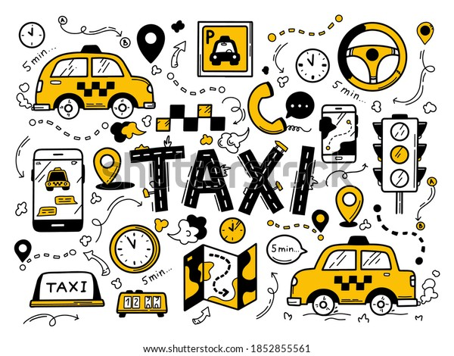
Taxi/Car Booking Application
Data structures and algorithms
- Abbas Muffadal Broach

Slide 2

Application Overview
–For this application, preferred IDE would be Eclipse for Enterprises
–What does the application do..

Slide 3
Problem Statement and Solution
To create a java application with concepts of Data Structures
To provide a service for commercial usage by the users
Solution
Application Development using the mentioned IDE.
Java Language
Provides simple yet effective solution
Does what it is supposed to – asks the user for appropriate inputs in regards to the working

Slide 4
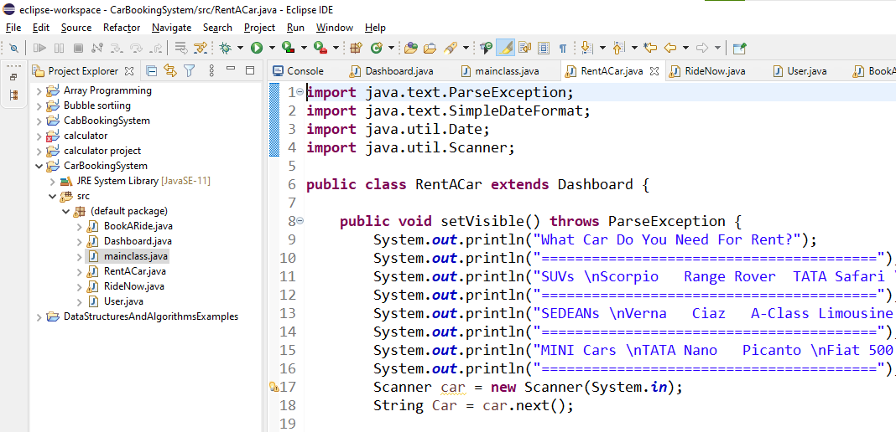
Software Requirement
- Any intel processors with at least a 7th Generation one
- Operating Systems it can run in include (Windows and Linux)
- IDE used is eclipse for JAVA Enterprise Users

Slide 5

Modules
-Included Relevant Libraries for the development process
Scanner.util
ParseException
SimpleDateFormat
Java.base
Java.sql
Development plan
Classes
Testing and
Finalization

Slide 6
Technical Background
Direct cab services
Rental options
Ride later features
Easy use
Relevant and basic information

Slide 7
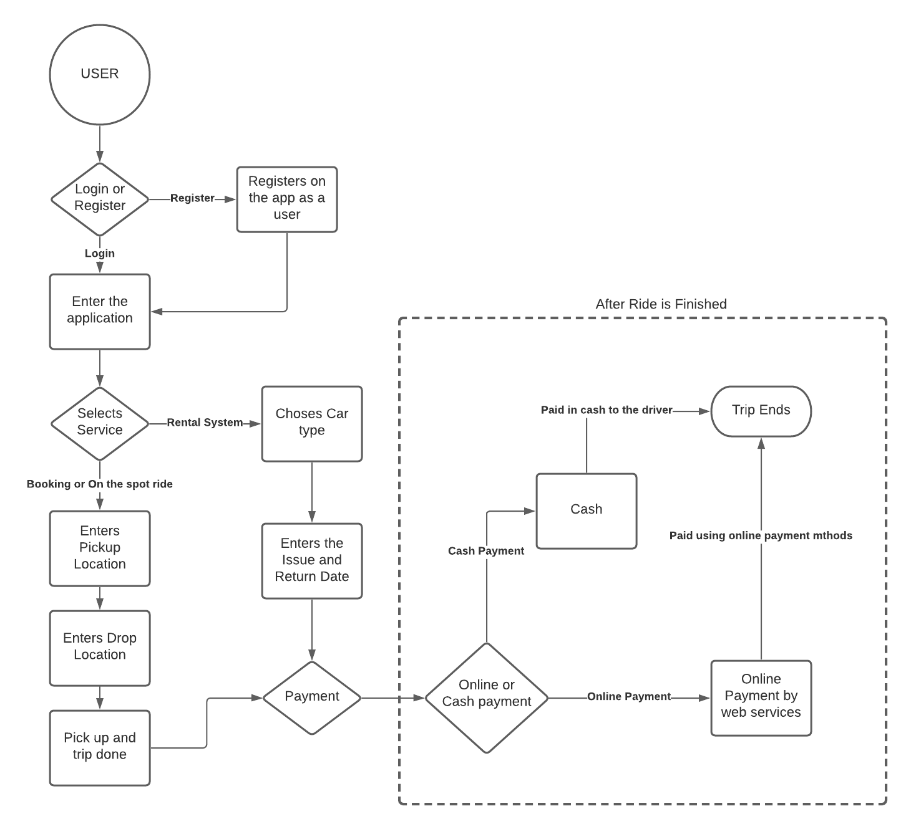
Architecture of the Application

Slide 8
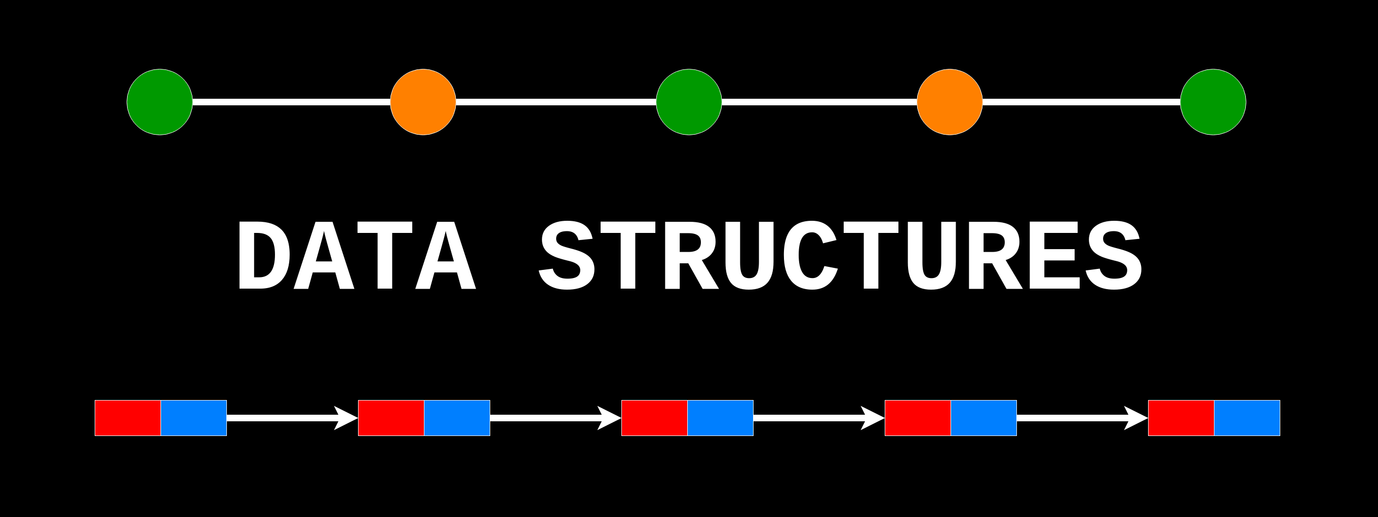
Data Structures
No solid GUI or a Web Application
Array Implementation, user information
Hashing and Hash Map
Security
Admin and User identification

Slide 9
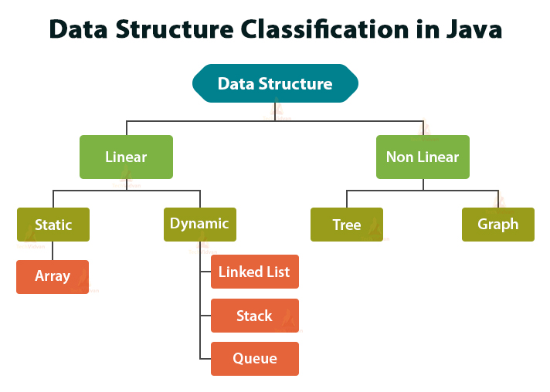
Abstract Data Types
- Stack
Map
List
List abstract data types can be used
Searching and Sorting
Database integration
Dynamic Application

Slide 10
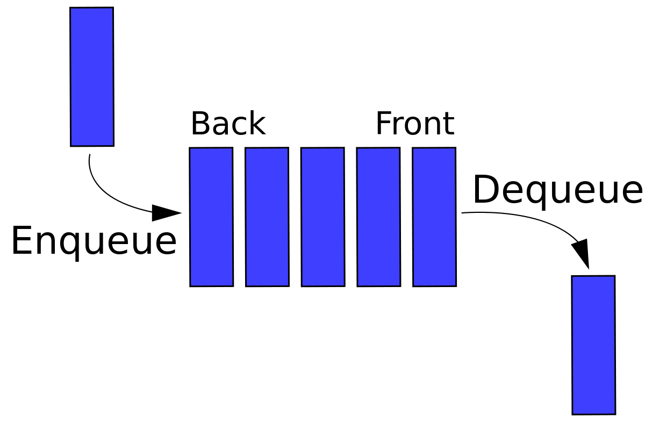
QUEUE
Linear Structure
FIFO
Operations on Queue:
1 Enqueue
2 Dequeue
3 Front
4 Rear

Slide 11
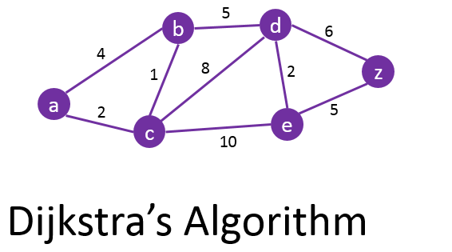
Error Handling and Shortest Path Algorithm
Similar to Prim’s Algorithm for minimum spanning tree
Two sets
Closest vertex from the other set
Steps….

Slide 12
Sorting Algorithm and Complexity
Complexity of Quicksort is O(n log n) in best and average case and O(n^2) at its worst
Depends on the input and who is using it.
Working of Quicksort
Pivot Point
Arrange the subarrays around it
Rearrange the subarrays around pivot and you have a sorted array

Slide 13
Original Array
Rearranging around the pivot
Subarray around the other side of the pivot
Continuing recursively
Sorted Array

Slide 14
Design Pattern
Best practices on OOPs
Solutions to general problems
Developed over a long time
Factory Pattern
Implementation

Slide 15
Understanding of the Application
After user enters the first input and chooses a service.
If they choose rent, booking, ride now. appropriate page opens
Takes the required information from user, processes it and
Gives you confirmation output.

Slide 16
Advantages and Disadvantages
Advantages
It provides simple interface
Is it easy to maintain and expand onto
Disadvantages
It does not have permanent storage
Database and html integration, end-to-end

Slide 17
Future Enhancements
Develop a Front end system for it
Make it user friendly for layman
Add complex code for sophistication faster processing
Add a filter system of username and password for distinguishing between admin and client.

Slide 18
References
1. https://sites.google.com/site/ignoubcafinalyearprojects/project-report/car-booking-management-system-project-report
2.http://www.ir.juit.ac.in:8080/jspui/bitstream/123456789/17209/1/SP13239_Nishant%20Singh_141417_CSE_2018.pdf
3. http://www.ir.juit.ac.in:8080/jspui/bitstream/123456789/17327/1/121294.pdf
4.https://books.google.co.in/books?hl=en&lr=&id=dJ_DXvFnIgoC&oi=fnd&pg=PR13&dq=DSA+concept+implementation+in+cab+booking+java&ots=irH-zWWQEY&sig=hOdM06GkB2VV6rHl7P79uvVJFMk#v=onepage&q&f=false
5.https://books.google.co.in/books?hl=en&lr=&id=iFc0DwAAQBAJ&oi=fnd&pg=PT20&dq=DSA+concept+implementation+in+cab+booking+java&ots=8pqxTdq2-q&sig=JUT3RkKeXZ_1CxF5sVQH0B5mX80#v=onepage&q&f=false
GitHub URL: https://github.com/ambroach/AMBROACH

Slide 19
THANK YOU!!

